Slide 1
Predicting Traffic Accident Severity in Indiana

Slide 2
Introduction
Is there a benefit to being able to predict the severity of an accident?
Yes!
Any person traveling Indiana roads could benefit from prediction
Driver could alter:
Vehicle driven
Route to avoid types of roads
Date of travel to avoid weather conditions

Slide 3
Data Acquisition & Cleaning
Full traffic accident data from Indiana for 2019
https://hub.mph.in.gov/dataset/aries-crash-data-2007-2017
625,702 rows with 107 columns in the dataset
Null values replaced with meaningful values
Removed columns with no value for prediction
Cleaned data contains 7 columns
2 datasets created for analysis
Multi-Severity: 7 values for severity i.e. Fatal, Incapacitating, No Injury etc.
Binary Severity: 2 values for severity - INJURY and NO INJURY

Slide 4
Decision Tree models
Columns utilized to predict severity:
Safety Equipment Used
Light Conditions
Weather,
Surface Type Condition
Road Type (ex. Multi-Lane, One-Way, etc.)
Vehicle Type
High accuracy for each dataset
Binary Severity dataset – 93.67%
Multi-Severity dataset – 94.60%

Slide 5
Logistic Regression
Columns utilized to predict severity:
Safety Equipment Used
Light Conditions
Weather,
Surface Type Condition
Road Type (ex. Multi-Lane, One-Way, etc.)
Vehicle Type
High accuracy for each dataset
Binary Severity dataset – 94%
Multi-Severity dataset – 94%

Slide 6
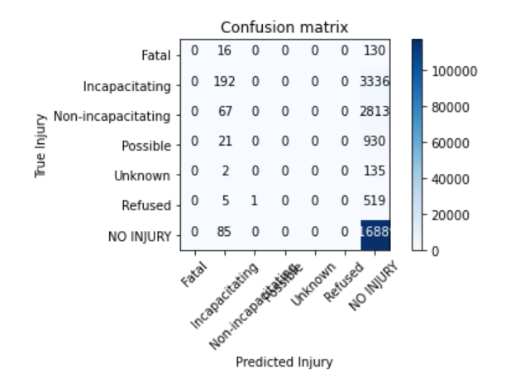
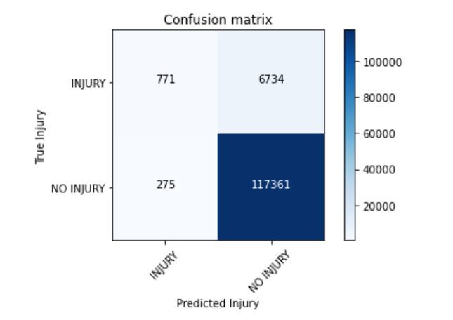
Logistic Regression cont.
Multi-Severity Dataset
Binary Severity Dataset

Slide 7
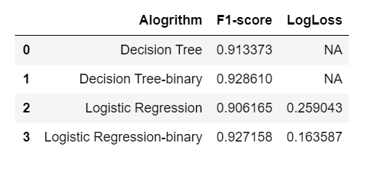
Model Evaluation

Slide 8
Conclusion & Future Thoughts
All models evaluated can be used to predict severity of accidents for drivers in Indiana
Users can select between models for Multi-Severity outcomes or Binary based on preference
Additional years of data could be evaluated to potentially increase accuracy and precision of models
Vehicle Type has a strong correlation with severity – potential for analysis for safety of vehicle classes

